Slide 1
PLC Programming Imperative Programming
Problems with large programs and the solution

Slide 2
What is Imperative Programming?
Definition
programming paradigm that focuses on describing how a program operates through a sequence of commands or statements that change a program's state. It emphasizes control flow and the explicit instructions required to manipulate data and control structures.

Slide 3
Key Features
Sequence of Commands:
Programs are composed of a series of commands that dictate the steps the computer must execute. Each command can modify variables, control flow, or produce output.
State Changes:
Programs maintain and modify the internal state through variables. The state represents the current values of the program’s data, and changes in state occur as a result of executing commands.
Detailed Control:
Imperative programming gives developers fine-grained control over the execution process. This is especially useful in applications where performance and resource management are critical.

Slide 4
Key Characteristics
Control Flow:
Control flow refers to the order in which individual statements, instructions, or function calls are executed in a program..
Types of Control Flow Structures:
Sequential Execution:
The default mode of execution where statements are executed one after the other in the order they appear.
Selection Statements:
Allow the program to make decisions based on conditions.
Iteration Statements
Used for repeating a block of code multiple times until a specified condition is met.

Slide 5
Key Characteristics
State Manipulation
State refers to the current values of variables in a program at a given point in time.
State Changes:
Programs change their state by modifying variables through assignment and expressions. This allows the program to keep track of information and make decisions based on its current state.

Slide 6
Key Characteristics
Low-Level Operations
Low-level operations refer to programming constructs that allow direct manipulation of hardware and memory.
Efficiency:
Imperative programming can lead to more efficient code as it allows developers to optimize resource usage and performance by directly controlling the execution flow and memory.

Slide 7
Conclusion
An in-depth look at the core characteristics of imperative programming, helping to establish a solid understanding of how imperative languages function and why they are structured this way. Each characteristic contributes to the overall effectiveness and efficiency of imperative programming.

Slide 8
PLC Programming -- Structure Programming
Benefits
Readability
Maintainability
Reusability
Reliability
Testability

Slide 9
PLC Programming
Solving the problem with writing big programs
Use programming paradigm
Structured programming is a programming paradigm aimed at improving the clarity, quality, and development time of a computer program by making extensive use of the structured control flow constructs of selection (if/then/else) and repetition (while and for), block structures, and subroutines in contrast to using simple tests and jumps such as the go to statement, which can lead to “spaghetti code” that is potentially difficult to follow and maintain.
https://press.rebus.community/programmingfundamentals/chapter/structured-programming/
Develop a framework
Descries a set of solutions and processes to aid in the development of software
Benefits
Saves time
Ensure best practices are followed

Slide 10
PLC Programming
Control Structures
The mechanisms that allow us to control the flow of execution are called .
Sequence
Do one instruction then the next and the next.
Just do them in a given sequence or in the order listed
Selection
Choose between two or more flows.
Iteration, Repetition or Looping
Allows code to be executed several times until some condition has been met
https://press.rebus.community/programmingfundamentals/chapter/structured-programming/

Slide 11
PLC Programming
Defining a Control Structure
That can run a sequence in a controlled fashion
Numerically Sequenced
To easily follow the path of execution
Can be skipped to improve cycle time
Use jump and label in a limit fashion
Stage and End Stage command
Controlled by an enable flag (bit)
Enter or start the Control Structure
Start process flag
Exit or stop the Control Structure
Stop process flag
Stop and cleans up the Control Structure process

Slide 12
PLC Programming
Each PLC provides a different way of accessing bits
So it up to the individual programmer to develop the control structure to meet the hardware constraints.
The following slide will show 3 different implementation used in various PLC

Slide 13
PLC Programming
Defining a Control Structure for Omron CX-Programmer

Slide 14
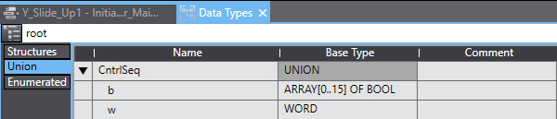
PLC Programming
Defining a Control Structure for Omron SYSMAC
In the SYSMAC environment
The use of Union was the best way I found to access the BITS in a WORD
Since a Union is a set of variables with same offset therefore occupies the same memory space.
Hence, b is array of 16 Boolean that can directly access the bits in the WORD.

Slide 15
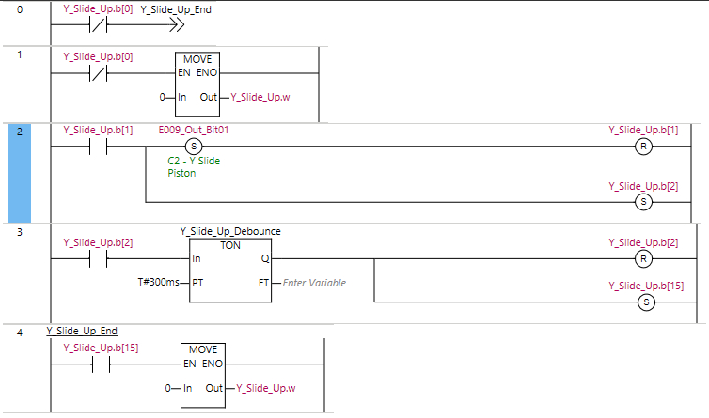
PLC Programming
Defining a Control Structure for Omron SYSMAC
In the SYSMAC environment
This the basic control structure that was developed.
Y_Slide_Up variable is defined by Union definition in the previous screen call CntrlSeq
Bit 0 is the enabling bit
If the Bit 0 is off, jump statement is enable and takes the execution of PLC code to the end of the control structure
Bit 1 is the Starting bit
Y_Slide_Up.b(1) rung sets an output variable “E009_Out_Bit01” then proceed to reset the current rung Y_Slide_Up.b(1) then set the next rung Y_Slide_Up.b(2) .
Y_Slide_Up.b(2) Rung enables a Timer On function block defined by time variable T#300ms.

Slide 16
PLC Programming
Defining a Control Structure for Omron SYSMAC
bit
In the SYSMAC environment
Y_Slide_Up.b(2) Rung enables a Timer On function block defined by time variable T#300ms.
Once the timer complete Y_Slide_Up.b(2) is reset and Y_Slide_Up.b(15) is set.
Y_Slide_Up.b(15) is the stop flag which activate the MOVE function that copy 0 to WORD portion that resets all of the bit in the CntrlSeq variable.

Slide 17
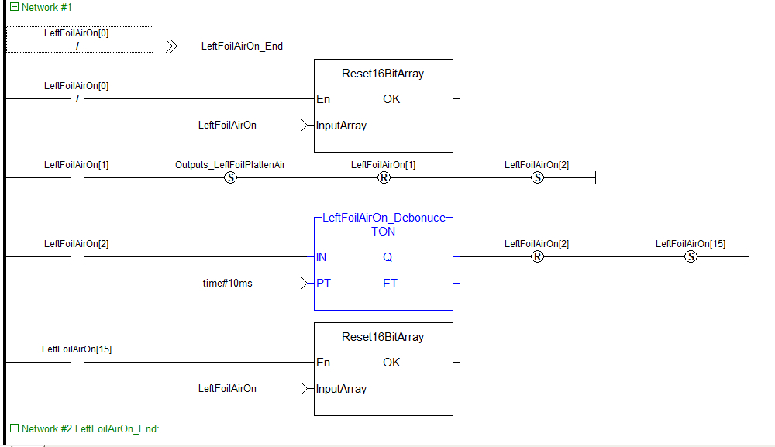
PLC Programming
Defining a Control Structure for Kollmorgen Automation Suite
LeftFoilOn[x] is an array of 16 bool
LeftFoilOn[0] is the Enabling bit
If LeftFoilOn[0] is Off the
-->> LeftFoilAitOn_End is the Jump Statement that bypasses this Network of code.
On Network #2: LeftFoilAirOn_End is the label that the Jump statement refers to.
The Reset16BitArray function block is used to reset the individual bits in the array
LeftFoilOn[1] is the starting bit for the block of code
LeftFoilOn[1] rung sets an output variable “Outputs_LeftFoilPlattenAir” then proceed to reset the current rung LeftFoilOn[1] then set the next rung LeftFoilOn[2].

Slide 18
PLC Programming
Defining a Control Structure for Kollmorgen Automation Suite : Continued
LeftFoilAirOn[2] Rung enables a Timer On function block defined by literal time variable time#10ms.
After 10ms the LeftFoilAirOn[2] rung is Reset and the Last Bit in the array is set to finish the block.
LeftFoilAirOn[15] activates the Reset16BitArray function block which reset the array of bits in the LeftFoilAirOn array thereby turning off the block of code.
This block code represents the basic building block of ladder logic that will be used to write your programs.

Slide 19
PLC Programming
Defining a Control Structure for Kollmorgen Automation Suite : Continued
LeftFoilAirOn[2] Rung enables a Timer On function block defined by literal time variable time#10ms.
After 10ms the LeftFoilAirOn[2] rung is Reset and the Last Bit in the array is set to finish the block.
LeftFoilAirOn[15] activates the Reset16BitArray function block which reset the array of bits in the LeftFoilAirOn array thereby turning off the block of code.
This block code represents the basic building block of ladder logic that will be used to write your programs.

